Slide 1
Gaming with Gestures
Submitted by :
Mohammed Anas Affaf (18AT1A0513)
A S Abdul Kalam (18AT1A0502)
Moulvi Kaif Ahmed (18AT1A0557)
Sheik Aslam Basha (18AT1A0522)
Project Guide :
Ms. M. Sri Lakshmi

Slide 2
CONTENTS
01
02
03
Abstract
Block Diagram
Expected Results
Brief description of Project
Proposed Model workflow
Preview of expected results
04
05
Hardware Requirements
Domain
Minimum requirements to run the script
Technologies Used

Slide 3
Brief Description (Abstract)
Virtual environments are designed to provide natural, efficient, powerful, and flexible human computer interaction. However, virtual worlds are not well-suited to the standard two-dimensional, keyboard-and-mouse-oriented graphical user interface. This will look at the most prevalent methods for capturing, monitoring, and recognizing many modalities at the same time in order to develop an intelligent human-computer interface for games. Given the wide range of gestures and their importance in building intuitive interfaces, the techniques under consideration concentrate on gestures, while they may be applied to other modalities as well. The methods under consideration are user-independent and do not need huge learning samples.
In this project, a model is developed that collects user gestures using a camera and uses the open-source free computer vision library OpenCV to convert real-time human motions into keyboard input for video game control.

Slide 4
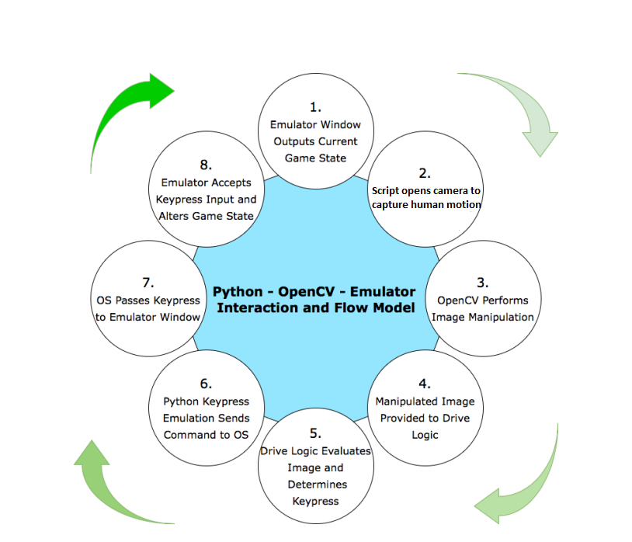
Flow Diagram of the proposed model.

Slide 5
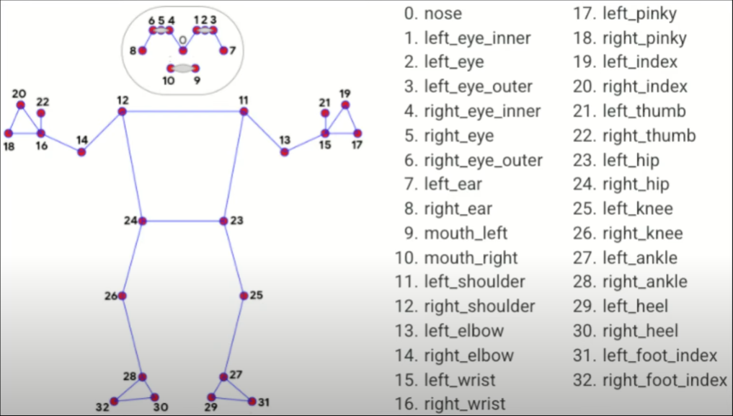
Frame Media Pipe Diagram

Slide 6
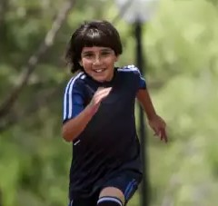
Expected Result
Gameplay
Motion Pose (is Running)

Slide 7
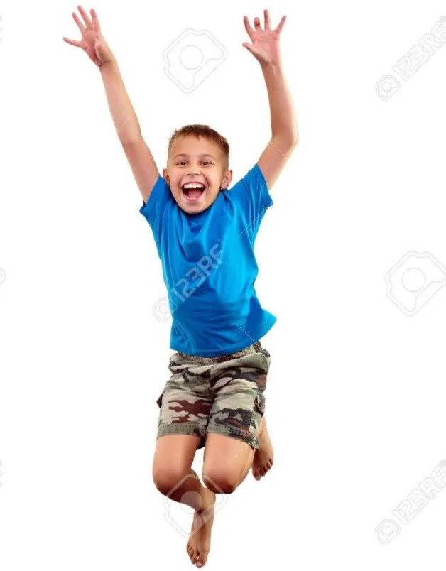
Expected Result
Gameplay
Motion Pose (is Jumping)

Slide 8
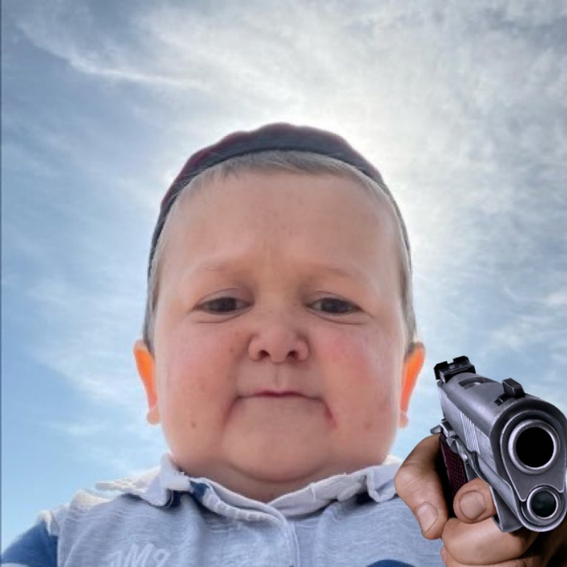
Expected Result
Gameplay
Motion Pose (is Shooting)

Slide 9
4 GB of Ram
i5 processor
Any GPU
Windows/Linux
Hardware
Requirements

Slide 10
OpenCV
Numpy
PyAutoGUI
Computer Vision
Deep learning
Technologies Used

Slide 11
THANK YOU

